Slide 1
ROAD TO MINDFULNESS
PROJECT REPORT WINTER SEMESTER 2020
by Ernestyne Jamelyn Lu (Jamie)
w0441213

Slide 2

INTRODUCTION
I have always been a person that gets very anxious about things. I tend to have an overactive imagination which hurts my growth as an individual. I have a very hard time practicing calmness and taking control of my mind. I have a hard time being positive and not overthinking things.
I went through a time in my life that was very dark, and I felt like I was in a rut. I had a dead-end job. I was unsure of where I was headed, and I had no plans. Prayer helped me a lot through that time and helped me determine what I wanted to do with my life. God saved me from that darkness, and I felt hope again.
I have become so busy with my life that I have stopped praying. I feel myself going back to my old self with all the anxiety and stress and I know that going back to God and praying will help me.
I chose this project because I believe that practicing mindfulness will enable me to grow as a human being. Mindfulness will help me focus and be calm.
I will practice mindfulness by using an application on my phone to be my guide and reminder. I will also revive my practice of praying before bed.

Slide 3

GOAL
Be able to practice mindfulness as a part of my daily routine.
Pray every night before bed.
Be able to reap the benefits of mindfulness and prayer.
This Photo by Unknown Author is licensed under CC BY

Slide 4
PERFORMANCE MEASURES
SUCESS
PRAYER
MINDFULNESS ACTIVITY OF THE DAY
DOCUMENTING THE RESULT OF THE SCHEDULED ACTIVITY OR SESSION OF THE PROGRAM
DOCUMENTING WHETHER OR NOT I HAVE PRAYED BEFORE BED

Slide 5
CONCEPT MODEL
MINDFULNESS is paying attention to what is actually happening, rather than what one thinks is happening. It is being completely focused and absorbed in what one is doing. It can be focusing on one’s own breath and then absorbing one’s surrounding with an open and curious mind. One can unleash their full potential when they are practicing mindfulness. One can practice mindfulness with even as little as 5 minutes a day.
- Smiling Mind App
Mindfulness means maintaining a moment-by-moment awareness of our thoughts, feelings, bodily sensations, and surrounding environment, through a gentle, nurturing lens. It involves acceptance, meaning that we pay attention to our thoughts and feelings without judging them—without believing, for instance, that there’s a “right” or “wrong” way to think or feel in a given moment. When we practice mindfulness, our thoughts tune into what we’re sensing in the present moment rather than rehashing the past or imagining the future.
- Greater Good Magazine
Mindfulness is the practice of purposely focusing your attention on the present moment—and accepting it without judgment. Mindfulness is now being examined scientifically and has been found to be a key element in stress reduction and overall happiness.
- Help Guide

Slide 6

DESIGN
With the goal and model in mind,
I will emphasize reduction of stress and anxiety.

Slide 7
SCHEDULE

Slide 8

Week 1 January 6 – January 12
Choose a project for COMM2700 Winter 2020 Semester
Find applications and tools that can supplement project
Create a work plan

Slide 9

Application Chosen:
SMILING MIND is a non-for-profit web and app-based meditation program. It was developed by psychologists and educators to help bring mindfulness into people’s lives.
To get more information on the application, visit https://www.smilingmind.com.au/about-us

Slide 10
Week 2 January 13 – January 19
DATE | ACTIVITY | RESULT | DID I PRAY?
January 13 | Monday | SMILING MIND: DO PROGRAM | STARTED INTRODUCTION TO MINDFULNESS PROGRAM | YES
January 14 | Tuesday | PRACTICE MINDFULNESS: FOCUS ON DOING ONE ACTIVITY, NO MULTITASKING. | FOCUSED ON BRUSHING MY TEETH W/O LOOKING AT MY PHONE | NO
January 15 | Wednesday | SMILING MIND: DO PROGRAM | WHY DO WE NEED MINDFULNESS | YES
January 16 | Thursday | SMILING MIND: DO PROGRAM | HOW TO PRACTICE MINDFULNESS | NO
January 17 | Friday | PRACTICE MINDFULNESS: FOCUS ON DOING ONE ACTIVITY, NO MULTITASKING. | FOCUSED ON EATING BREAKFAST ALONE WITH NO MUSIC OR TV. | NO
January 18 | Saturday | MEDITATE 5 MINUTES | MEDITATED FOR 5 MINUTES | NO
January 19 | Sunday | SMILING MIND: DO PROGRAM | WHAT IS MINDFULNESS – 2 MINUTE PRACTICE | YES

Slide 11
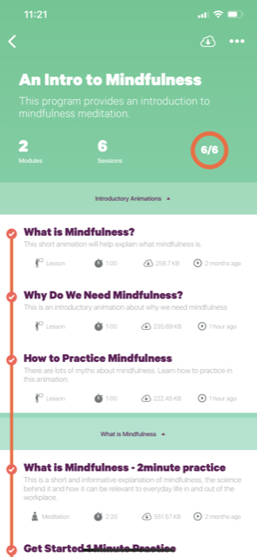
D O C U M E N T A T I O N

Slide 12
Week 3 January 20 - January 26
DATE | ACTIVITY | RESULT | DID I PRAY?
January 20 | Monday | SMILING MIND: DO PROGRAM | 1 MINUTE PRACTICE - MINDFULNESS | YES
January 21 | Tuesday | PRACTICE MINDFULNESS: FOCUS ON DOING ONE ACTIVITY, NO MULTITASKING | FOCUSED ON DOING MY MAKE UP WITHOUT WATCHING TV OR LISTENING TO MUSIC | YES
January 22 | Wednesday | SMILING MIND: DO PROGRAM | THE NEXT STEP – 6 MINUTE PRACTICE | YES
January 23 | Thursday | MEDITATE 5 MINUTES | MEDITATED 5 MINUTES | NO
January 24 | Friday | SMILING MIND: DO PROGRAM | THE BODY SCAN MEDITATION | NO
January 25 | Saturday | PRACTICE MINDFULNESS: FOCUS ON DOING ONE ACTIVITY, NO MULTITASKING | FOCUSED ON COOKING WITHOUT WATCHING NETFLIX | YES
January 26 | Sunday | SMILING MIND: DO PROGRAM | BREATH AND SOUNDS MEDITATION | YES

Slide 13
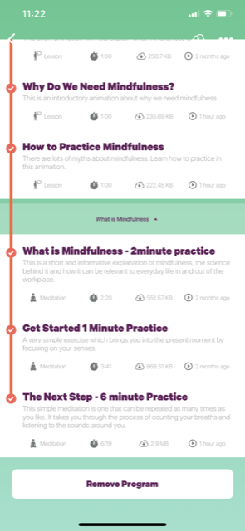
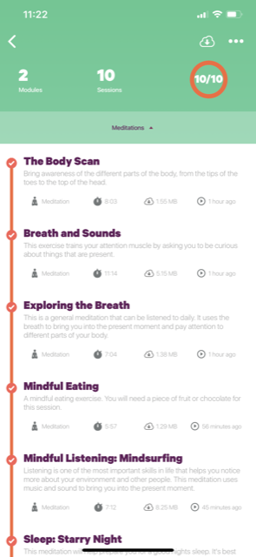
D O C U M E N T A T I O N

Slide 14
Week 4 January 27-February 2
DATE | ACTIVITY | RESULT | DID I PRAY?
January 27 | Monday | MEDITATE 5 MINUTES | MEDITATED FOR 5 MINUTES | YES
January 28 | Tuesday | MEDITATE 5 MINUTES & PRACTICE MINDFULNESS: FOCUS ON DOING ONE ACTIVITY, NO MULTITASKING | MEDITATED AND FOCUSED ON DOING HOMEWORK | YES
January 29 | Wednesday | MEDITATE 5 MINUTES | MEDITATED FOR 5 MINUTES | YES
January 30 | Thursday | SMILING MIND: DO PROGRAM | EXPLORING THE BREATH | YES
January 31 | Friday | SMILING MIND: DO PROGRAM | MINDFUL EATING | YES
February 1 | Saturday | MEDITATE 5 MINUTES & PRACTICE MINDFULNESS: FOCUS ON DOING ONE ACTIVITY, NO MULTITASKING | MEDITATED AND FOCUSED ON CLEANING MY ROOM | NO
February 2 | Sunday | MEDITATE 5 MINUTES | MEDITATED FOR 5 MINUTES | NO

Slide 15
D O C U M E N T A T I O N

Slide 16
Week 5 February 3 - February 9
DATE | ACTIVITY | RESULT | DID I PRAY?
February 3 | Monday | SMILING MIND: DO PROGRAM | MINDFUL LISTENING: MINDSURFING | NO
February 4 | Tuesday | MEDITATE 5 MINUTES & PRACTICE MINDFULNESS: FOCUS ON DOING ONE ACTIVITY, NO MULTITASKING | MEDITATED AND FOCUSED ON FOLDING LAUNDRY | NO
February 5 | Wednesday | SMILING MIND: DO PROGRAM | SLEEP: STARRY NIGHT | YES
February 6 | Thursday | MEDITATE FOR 5 MINUTES | MEDITATED FOR 5 MINUTES | YES
February 7 | Friday | SMILING MIND: DO PROGRAM | CHOOSING TO DO THINGS MINDFULLY | NO
February 8 | Saturday | MEDITATE 5 MINUTES & PRACTICE MINDFULNESS: FOCUS ON DOING ONE ACTIVITY, NO MULTITASKING | MEDITATED AND FOCUSED ON DOING HOMEWORK | YES
February 9 | Sunday | MEDITATE FOR 5 MINUTES | MEDITATED FOR 5 MINUTES | YES

Slide 17
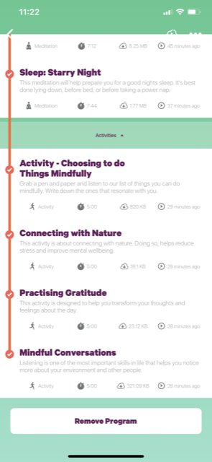
D O C U M E N T A T I O N

Slide 18
Week 6 February 10 - February 16
DATE | ACTIVITY | RESULT | DID I PRAY?
February 10 | Monday | SMILING MIND: DO PROGRAM | CONNECTING WITH NATURE | NO
February 11 | Tuesday | MEDITATE 5 MINUTES & PRACTICE MINDFULNESS: FOCUS ON DOING TWO ACTIVITIES, NO MULTITASKING | MEDITATED AND FOCUSED ON DOING MY MAKE UP VACUUMING | YES
February 12 | Wednesday | MEDITATE FOR 5 MINUTES | MEDITATED FOR 5 MINUTES | YES
February 13 | Thursday | SMILING MIND: DO PROGRAM | PRACTISING GRATITUDE | YES
February 14 | Friday | SMILING MIND: DO PROGRAM | MINDFUL CONVERSATIONS | YES
February 15 | Saturday | MEDITATE 5 MINUTES & PRACTICE MINDFULNESS: FOCUS ON DOING TWO ACTIVITIES, NO MULTITASKING | MEDITATED AND FOCUSED ON FOLDING LAUNDRY ORGANIZING MY CLOTHES | NO
February 16 | Sunday | SMILING MIND: DO PROGRAM | THE BODY SCAN | YES

Slide 19
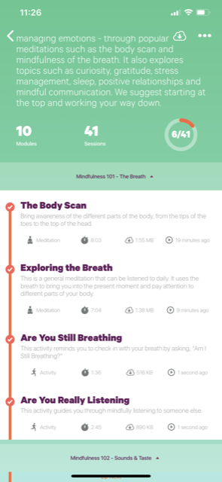
D O C U M E N T A T I O N

Slide 20
Week 7 February 17 - February 23
DATE | ACTIVITY | RESULT | DID I PRAY?
February 17 | Monday | MEDITATE FOR 5 MINUTES | MEDITATED FOR 5 MINUTES | NO
February 18 | Tuesday | MEDITATE 5 MINUTES & PRACTICE MINDFULNESS: FOCUS ON DOING TWO ACTIVITIES, NO MULTITASKING | MEDITATED AND FOCUSED ON DOING HOMEWORK | NO
February 19 | Wednesday | MEDITATE FOR 5 MINUTES | MEDITATED FOR 5 MINUTES | YES
February 20 | Thursday | SMILING MIND: DO PROGRAM | EXPLORING THE BREATH | YES
February 21 | Friday | SMILING MIND: DO PROGRAM | ARE YOU STILL BREATHING? | NO
February 22 | Saturday | MEDITATE 5 MINUTES & PRACTICE MINDFULNESS: FOCUS ON DOING TWO ACTIVITY, NO MULTITASKING | MEDITATED AND FOCUSED ON WATCHING A MOVIE | YES
February 23 | Sunday | MEDITATE FOR 5 MINUTES | MEDITATED FOR 5 MINUTES | NO

Slide 21
D O C U M E N T A T I O N

Slide 22
Week 8 February 24 – March 1
DATE | ACTIVITY | RESULT | DID I PRAY?
February 24 | Monday | SMILING MIND: DO PROGRAM | ARE YOU REALLY LISTENING? | YES
February 25 | Tuesday | MEDITATE 5 MINUTES & PRACTICE MINDFULNESS: FOCUS ON DOING TWO ACTIVITIES, NO MULTITASKING | MEDITATED AND FOCUSED ON DOING MY MAKE UP BRUSHING MY TEETH | YES
February 26 | Wednesday | MEDITATE FOR 5 MINUTES | MEDITATED FOR 5 MINUTES | NO
February 27 | Thursday | MEDITATE FOR 5 MINUTES | MEDITATED FOR 5 MINUTES | YES
February 28 | Friday | SMILING MIND: DO PROGRAM | RELATIONSHIPS | YES
February 29 | Saturday | MEDITATE 5 MINUTES & PRACTICE MINDFULNESS: FOCUS ON DOING TWO ACTIVITIES NO MULTITASKING | MEDITATED AND FOCUSED ON EATING DINNER DOING HOMEWORK | NO
March 1 | Sunday | MEDITATE FOR 5 MINUTES | MEDITATED FOR 5 MINUTES | YES

Slide 23
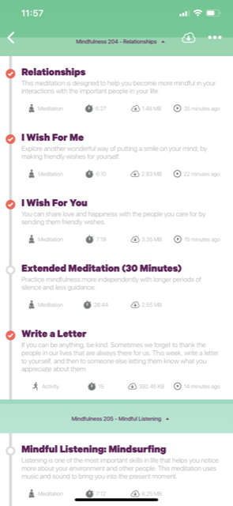
D O C U M E N T A T I O N

Slide 24
Week 9 March 2 – March 8
DATE | ACTIVITY | RESULT | DID I PRAY?
March 2 | Monday | SMILING MIND: DO PROGRAM | I WISH FOR ME | YES
March 3 | Tuesday | MEDITATE 5 MINUTES & PRACTICE MINDFULNESS: FOCUS ON DOING THREE ACTIVITIES, NO MULTITASKING | MEDITATED AND FOCUSED ON DOING HOMEWORK BRUSHING MY TEETH DOING MY MAKE UP | NO
March 4 | Wednesday | MEDITATE FOR 5 MINUTES | MEDITATED FOR 5 MINUTES | YES
March 5 | Thursday | SMILING MIND: DO PROGRAM | I WISH FOR YOU | YES
March 6 | Friday | MEDITATE FOR 5 MINUTES | MEDITATED FOR 5 MINUTES | YES
March 7 | Saturday | MEDITATE 5 MINUTES & PRACTICE MINDFULNESS: FOCUS ON DOING THREE ACTIVITIES, NO MULTITASKING | MEDITATED AND FOCUSED ON FOLDING LAUNDRY WATCHING A MOVIE ORGANIZING MY BEDROOM | YES
March 8 | Sunday | SMILING MIND: DO PROGRAM | MINDFUL CONVERSATIONS | YES

Slide 25
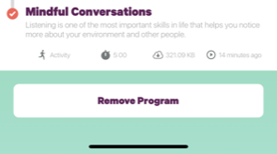
D O C U M E N T A T I O N

Slide 26


Completed 24 Sessions
This Photo by Unknown Author is licensed under CC BY-SA
This Photo by Unknown Author is licensed under CC BY-SA-NC

Slide 27
ANALYSIS & CONNECTION
What insights did you gain from the assignment?
I realized how much I overthink things. I realized how my mind likes to create scenarios that causes me to stress and get anxious. I realized how being more optimistic and relaxing helps with this and by fixing my anxiety and stress I can sleep soundly and on time.
I realized how sometimes we just must take a step back and breathe.
How might you have improved the project?
Reading the Bible every other night to start out, then every night before prayer and bed
Creating a journal of the thoughts I have during meditation
How did the assignment improve your professional practice? (ie. What skills did you gain?)
I realized how meditation can help with being more productive because it helps with practicing focus to finish a task on time and with utmost care.
A clear mind and heart helps a person be more productive in their everyday life. It helps with managing with multiple tasks, stress, and unexpected events

Slide 28
Learned Skills:
Mindful listening
Mindful eating
Meditation
Body Scan Meditation
Breath and Sounds Meditation
Connecting with nature
Mindfully doing things
Mindful interactions

Slide 29
CONCLUSION
I never thought how much useful and amazing meditation and prayer is. I realized so many things about myself, my fears, my worries, my thoughts. I have also realized how sometimes I just create the craziest scenarios that just cause me unnecessary stress. Meditation has helped clear my mine and think more rationally to get rid of these. Prayer has also helped so much because it has given me great peace of mind knowing that I have God protecting me, guiding me, and always being there for me.
It is so easy to get swallowed up by the world and forget what really matters. From the project, I realized how sometimes we just must take a step back and breathe.
This project will help with my professional practice because it helps with organization, handling stress, and with interacting and connecting with other people.
I am very happy and grateful to have had the opportunity to do this project. I never would’ve tried to know about meditation if it weren’t for the project. I also feel more at peace knowing I have reconnected with God through prayer.

Slide 30
References
Mindfulness Definition: What Is Mindfulness. (n.d.). Retrieved from https://greatergood.berkeley.edu/topic/mindfulness/definition
Benefits of Mindfulness. (2019, August 19). Retrieved from https://www.helpguide.org/harvard/benefits-of-mindfulness.htm
Smiling Mind. (n.d.). Retrieved from https://www.smilingmind.com.au/
BACK

